Slide 1
Predictive Analytics
for Retail Sales
Forecasting Daily Store Sales — Rossmann Store Sales Dataset
End-to-End Predictive Analytics Project — Task 01

Slide 2
Project Pipeline
Seven stages, from raw data to business insight
Data
Collection
→
Data
Cleaning
→
Feature
Engineering
→
Model
Training
→
Hyperparameter
Tuning
→
Model
Evaluation
→
Business
Insights
Dataset: 1,017,209 daily records across 1115 stores, 2013-01-01 to 2015-07-31.

Slide 3
Data Collection & Cleaning
Getting to a trustworthy modeling set
Source: Rossmann Store Sales — 1,017,209 rows, 9 columns
No missing values, no duplicate rows
Removed closed-store days (Open = 0) — these have trivial zero Sales
844,392 rows remain for modeling
StateHoliday kept as a raw category — encoded properly inside the pipeline, not mapped to an arbitrary numeric scale
Why filter closed days?
A closed store always sells zero. Leaving those rows in lets a model ‘cheat’ by learning Open → 0, instead of learning real demand patterns for the days that matter for forecasting.

Slide 4
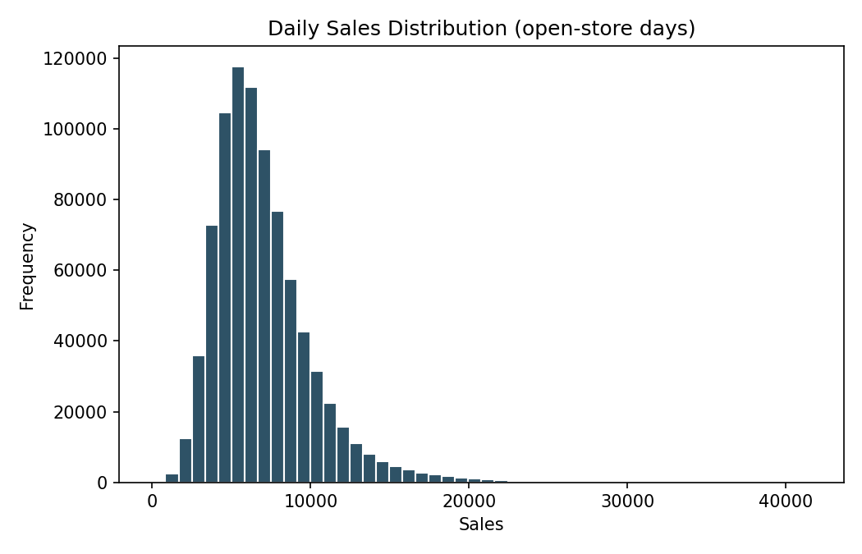
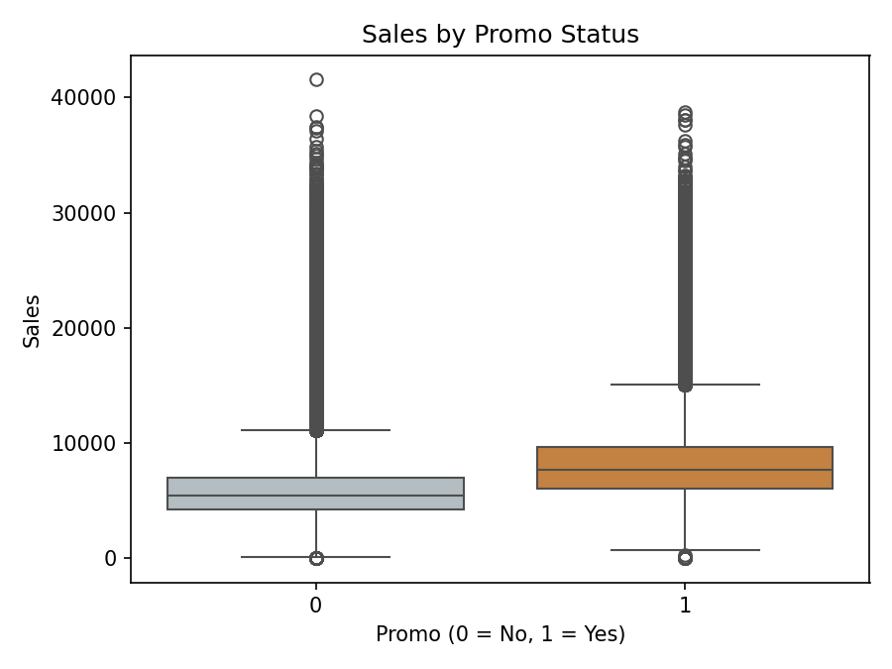
Exploratory Data Analysis
What the data looks like before modeling
Sales are right-skewed; running a promotion visibly shifts the distribution upward.

Slide 5
The Leakage Problem
The single most important finding in this project
Customers correlates ~0.82 with Sales — the strongest of any field. But Customers is measured on the same day as Sales, so it isn't known in advance. Using it as a model input inflates performance with information that won't exist at prediction time.

Slide 6
Model Training — A Real sklearn.Pipeline
Preprocessing and model bundled as one deployable object
Raw Features
→
ColumnTransformer
→
XGBRegressor
→
Sales Prediction
Store, DayOfWeek,
Promo, StateHoliday,
calendar features
One-hot encodes
StateHoliday
Tuned, early-stopped
gradient boosting
Deployable as one
Pipeline object
Fit only on training data — no leakage from encoding before the train/test split.

Slide 7
Hyperparameter Tuning
RandomizedSearchCV over the full pipeline
Parameter | Best Value
subsample | 0.7
reg_lambda | 1
min_child_weight | 1
max_depth | 6
learning_rate | 0.2
colsample_bytree | 0.9
Search includes regularization params (reg_lambda, min_child_weight) — the main lever against overfitting
cv=2, n_iter=6 kept the search fast on ~840K rows / single core
Final model refit with best params + early stopping on a validation split

Slide 8
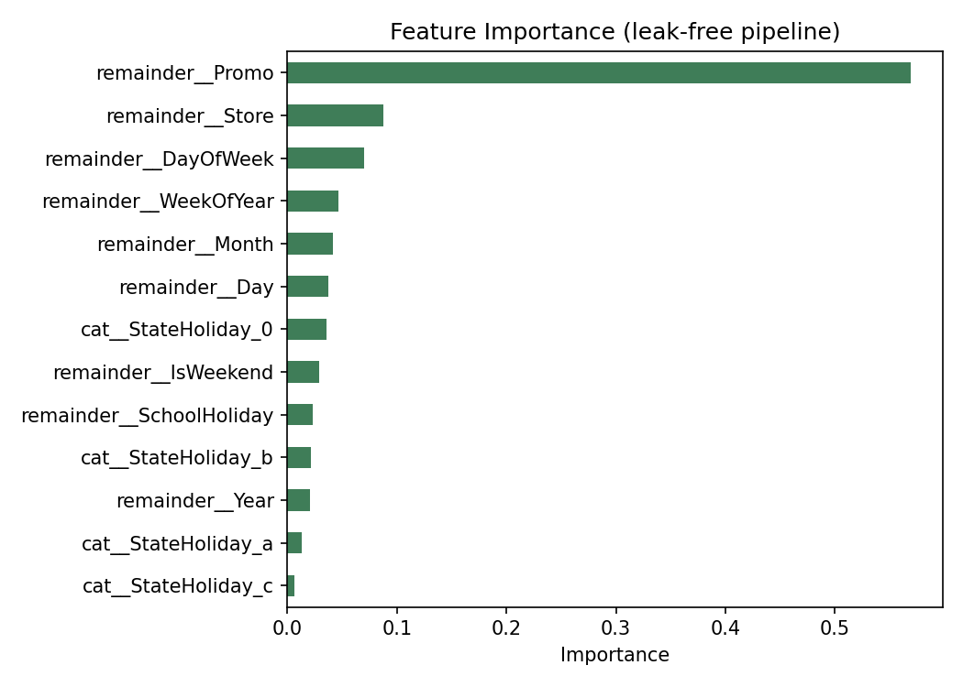
Model Evaluation
Leak-free performance on the held-out test set
RMSE
MAE
R2 (leak-free)
2419
1763
0.393

Slide 9
Business Insights
What the model tells us about the business
Promotions are the strongest lever known in advance — Promo is the top feature; running one measurably lifts sales
Store identity matters a lot — baseline sales differ substantially by location, size, and demographics
Calendar effects (weekday, week of year, month) are real but secondary — useful for staffing and inventory planning
Customers should not be used as a forecasting input — it isn't known ahead of time, even though it's the strongest raw correlate of Sales
Report honestly: the model explains ~39% of test variance — harder than the leaked ~89%, but the number that reflects real deployment

Slide 10
Q1 — 99% Train vs. 74% Test Accuracy
Root cause: overfitting
Model memorizes training-set noise instead of generalizable patterns
Often driven by excess complexity, unrepresentative training data, or leaky/noisy features
Fixes for better generalization
Regularization (reg_alpha, reg_lambda, min_child_weight, subsample/colsample_bytree)
Early stopping on a validation set
Cross-validation during hyperparameter search
Feature selection & leakage audits (as done with Customers here)
More / more diverse training data; simpler models or ensembling
Note: SMOTE and stratified splitting are classification-imbalance techniques and don't apply to this regression problem.

Slide 11
Q2 — Scaling to 50 Million Records
Redesigning the workflow for volume
Storage: CSV → Parquet (columnar, compressed, column/predicate pushdown)
Engine: pandas → Dask / Polars / Spark for distributed, out-of-core processing
Prototype on a representative sample; port the finalized pipeline to full data
Distributed / GPU training: Dask-XGBoost, Spark's XGBoost integration, or tree_method='hist' + GPU
Lighter search on the sample, one final full-data fit with early stopping
Chunked/batched evaluation; spot compute for exploration, on-demand only for the final run

Slide 12
Thank You
A leak-free, pipeline-based forecasting model — R2 = 0.39 — with clear business insights and a scaling plan to 50M+ records.

